Slide 1
DT COMMERCE DATABASE
PRESENTED BY VICTORIA ATASIE
JULY 7,2023

Slide 2
BACKGROUND
DT was consulted by an e-commerce client (DT Commerce) to assist them in resolving data silo issues by combining data from various third-party softwares like salesforce (CRM), ERP system (inventory management system), and quickbooks (financial system) and as a Data Analyst ,I was assigned to the project to solve the data silo issues by ingesting data into a relational database that will act as the source of truth for all datasets.

Slide 3
GOALS
To design an Entity Relationship Diagram(ERD) that will visually depict the entities, attributes, and relationships within a DTcommerce database system.
An Ecommerce ER Diagram designed for DTcommerce’s relational database for the Customer, Product and Sales table.Load data into its respective tables and write SQL query to validate all three tables
DTcommerce database would be able to store,manage,retrieve and update data successfully.
Cardinality indicator such 1,0,1 or many represented and number of occurrence specified for each entity.
Primary keys and Foreign Keys notation where the Primary Keys are the unique identifiers and Foreign Keys enforces referential integrity to show relationship between entities in the table.
The ERD will give a visual representation for the DTcommerce database to help the Ecommerce client understand the relationship of various tables and the structure of the database system

Slide 4
METHODOLOGY
Two major methodology was used to resolve DT commerce data silo issues.
Firstly,I gathered information,understood the requirement and the goals of the database system which includes identifying the entities,attributes and relationship that need to be modelled by designing the ER diagram to show a visual representation of the how the dataset would be created and stored in the relational database.
Furthermore,I created a database in a relational database management system called PostgreSQL to enable DTcommerce customer,sales and product data to be created,stored,retrieved,managed,and updated effectively.
THE ER DIAGRAM
Lucidchart,a diagramming application tool was used to design the ER diagram to show the customer,sales and product as entities with their attributes ,relationship and cardinality established.The primary keys(PK) that uniquely identifies ,foreign key(FK)was also determined which references the primary key in another table whilst establishing a link between tables.The relationship and cardinality between entities was established as one to many relationship.
Data types of each attributes was determined by identifying the value of the respective attributes as integer(numbers without fraction),varchar(strings with letter,numbers and special characters),float(decimal number)and date(date format).
Elimination of redundancy and data integrity was ensured .A proper review with the Ecommerce client to validate accuracy and effectiveness of the database design was conducted.
DATABASE CREATION WITH POSTGRESQL
DTcommerce database was created in the database system where the customer,sales,product table was created and populated with data by using the Copy command,From clause and the data file path.

Slide 5
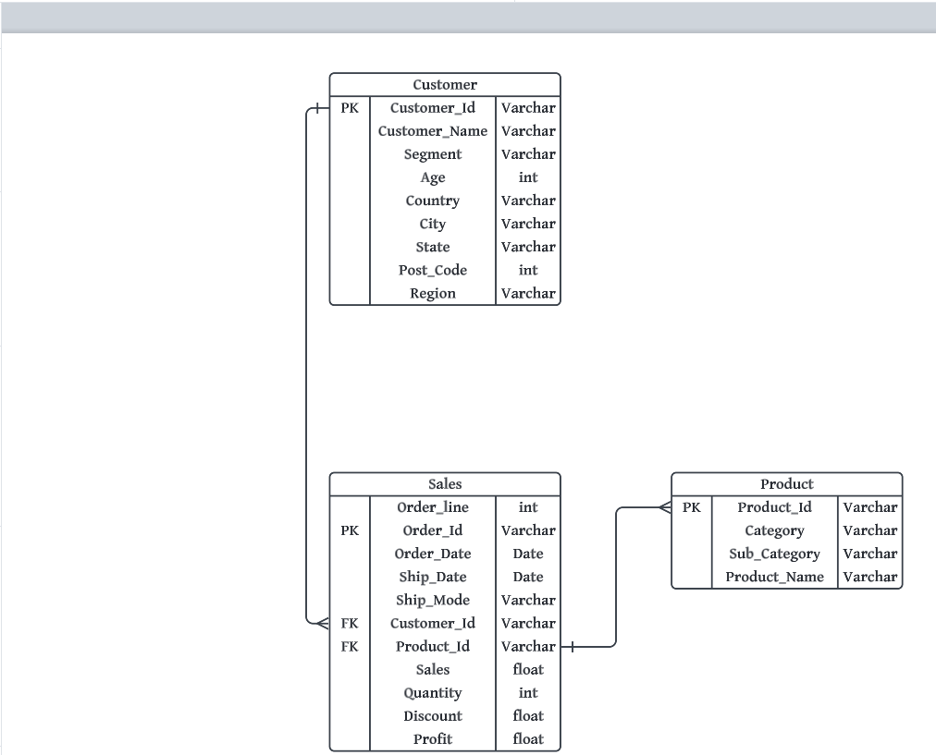
DTCOMMERCE’S ER DIAGRAM SNAPSHOT

Slide 6
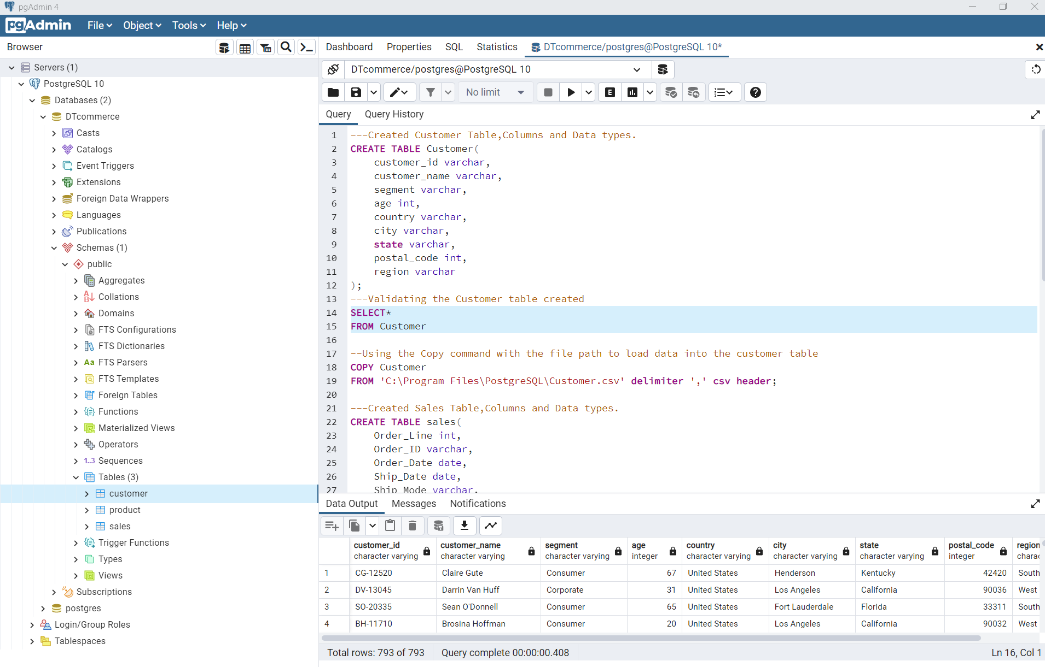
SQL SCRIPT FOR CUSTOMER DATA IN DTCOMMERCE’S DATABASE

Slide 7
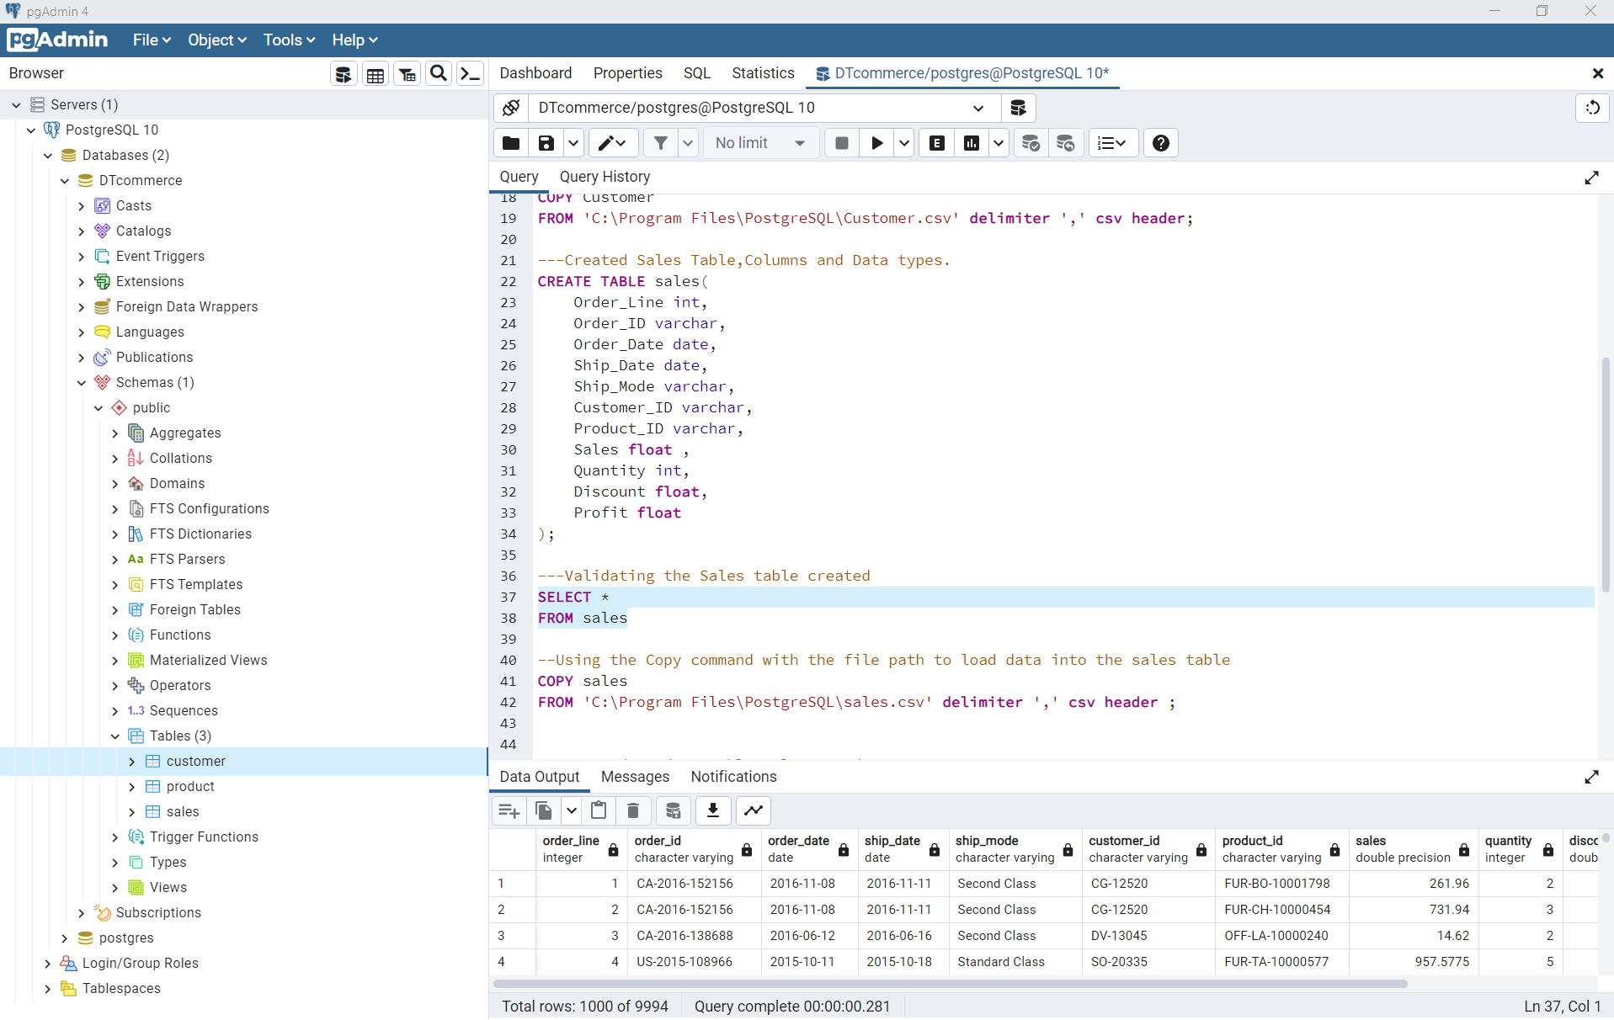
SQL SCRIPT FOR SALES DATA IN DTCOMMERCE’S DATABASE

Slide 8
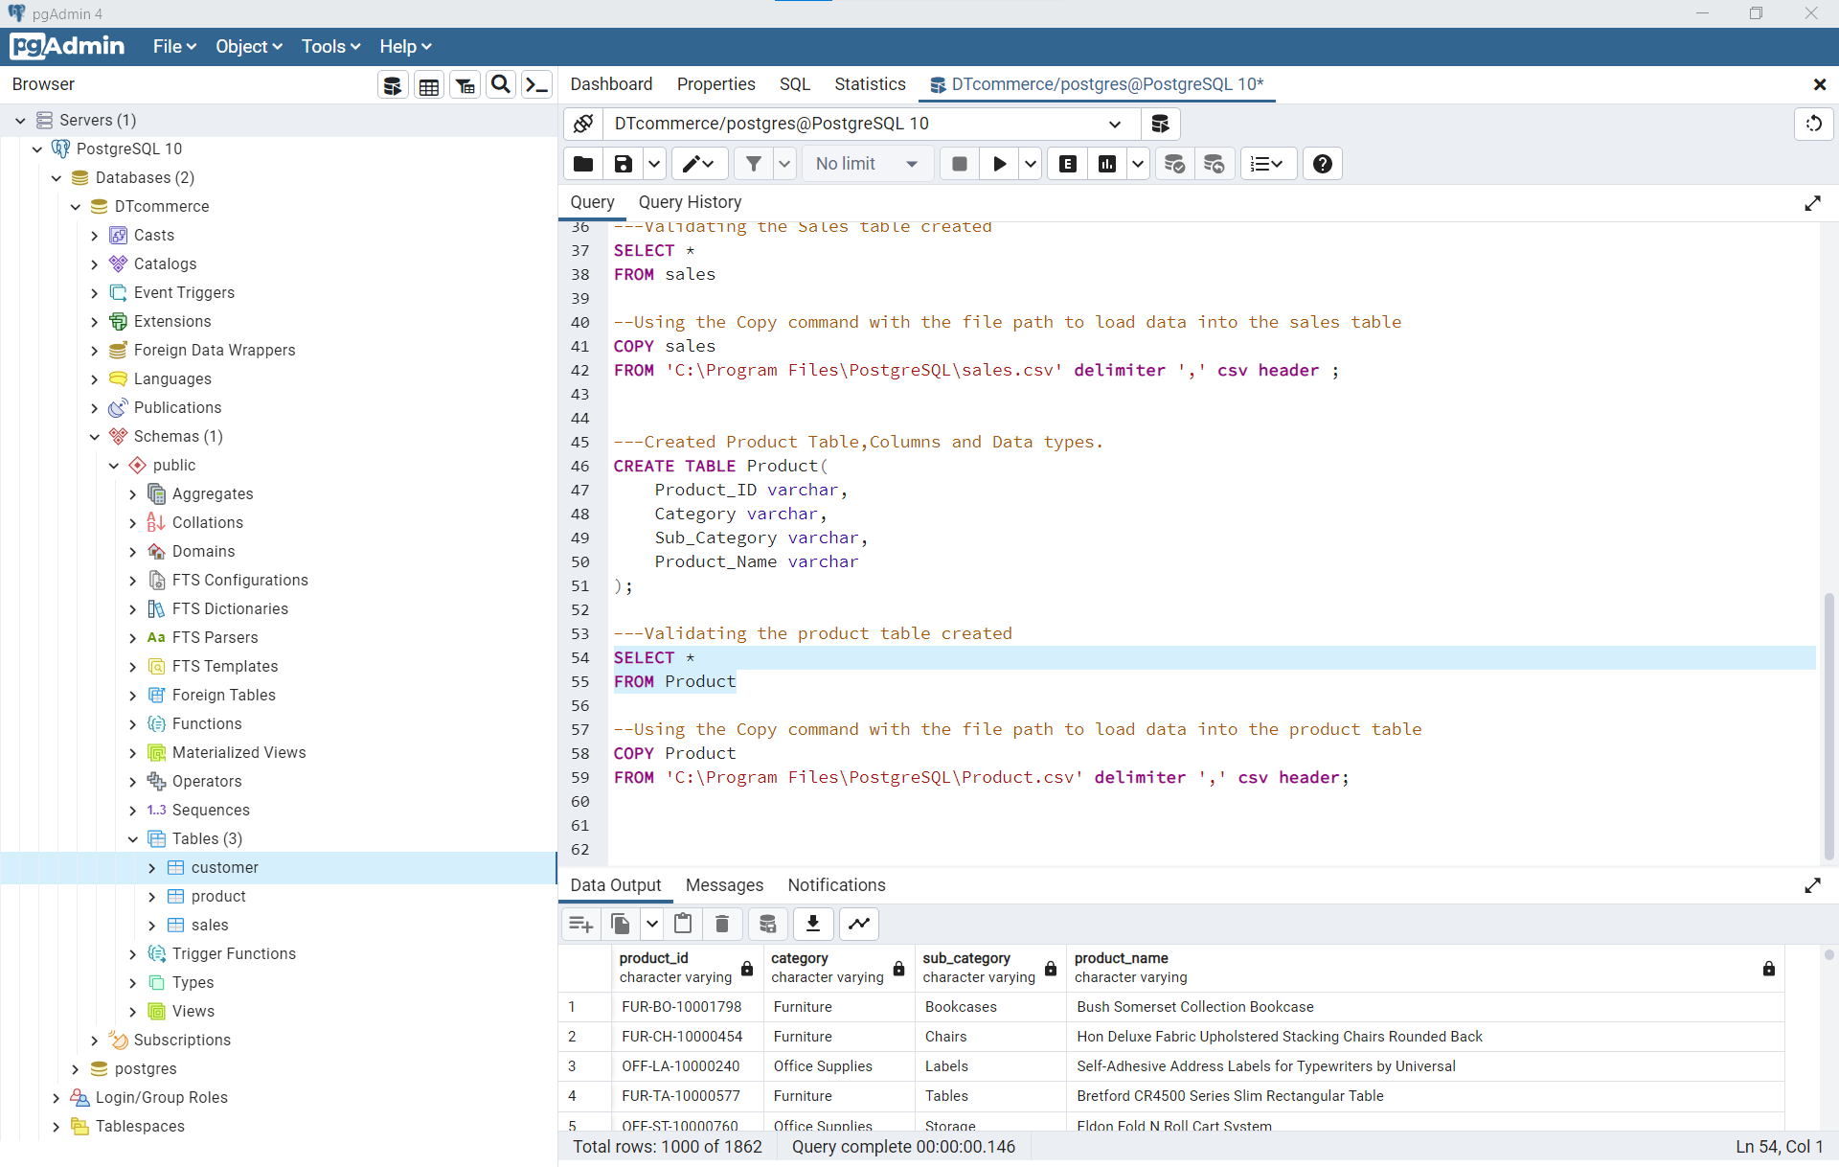
SQL SCRIPT FOR PRODUCT DATA IN DTCOMMERCE’S DATABASE

